Slide 1
Chicago Traffic Crash Analysis
Team 4:
Manojkumar Yerraguntla
Sai Narayana Murthy Dontukurti
Satya Bharath Reddy Duvvi

Slide 2
Scope of the project
The goal of this project is to analyze and understand the trends and patterns in traffic crashes, which pose an ongoing threat with significant implications for public safety.
Our primary focus will be on in-depth analysis within the city of Chicago, where attention to crashes has surged, particularly in the aftermath of the COVID-19 pandemic.
Lockdown measures and shifts in commuting habits have directly shaped traffic patterns and altered accident rates.
Traffic crashes have garnered significant public attention, and our dataset is robust, encompassing over 500,000 traffic incidents, offering a rich source of information for our analysis.

Slide 3
Dataset & Features
Traffic crashes Chicago – This contains data related to traffic accidents in Chicago,
including details about individuals and vehicles involved.
(Dataset is extracted from Kaggle)
Features:
We have a total of 148 features in the dataset, some of the important features are:
1. RD_no: Reference number or identifier for a specific traffic accident or incident.
2. Crash_Date: Date at which the crash happened includes time as well.
3. Posted_speed_limit: Speed limit at the area where the incident occurred.
4. Traffic_control_device: Tells us about if there is any traffic signs present in the area.
5. Weather_condition: Condition of weather during the time of the incident.
6. Lightning_condition: provides information about whether the accident occurred in daylight or under specific lighting conditions.
7. Damage: This would provide a quantitative measure of the financial impact of the accident.
8. Latitude and Longitude: This gives the location points at which the accident occurred.

Slide 4
Expected Outcomes
Identification of High-Risk areas:
Identify specific areas in
Chicago with highest crash rates.
01
02
Trend Analysis: can reveal trends in traffic accidents.
03
Primary factors: Determine the factors that cause accidents.
04
Climatic Conditions: Does Light and weather impact the accident?

Slide 5





AWS Architecture
AWS
QuickSight
Static
Website
Dataset
S3 Bucket
AWS Glue
S3 Bucket
S3 Bucket

Slide 6
Data Flow
Kaggle
S3 Bucket
AWS Glue
S3 Bucket
QuickSight
S3 Bucket
Static
Website
Download a dataset
from
Kaggle.
Store the
cleaned and
transformed data in
S3 Bucket
Create
interactive
visualizations
using cleaned
data
Store the
dataset in
S3 Bucket.
Clean and
transform
the data
Store
visualizations
in S3 Bucket
Host a Static website to
present our
dashboard

Slide 7
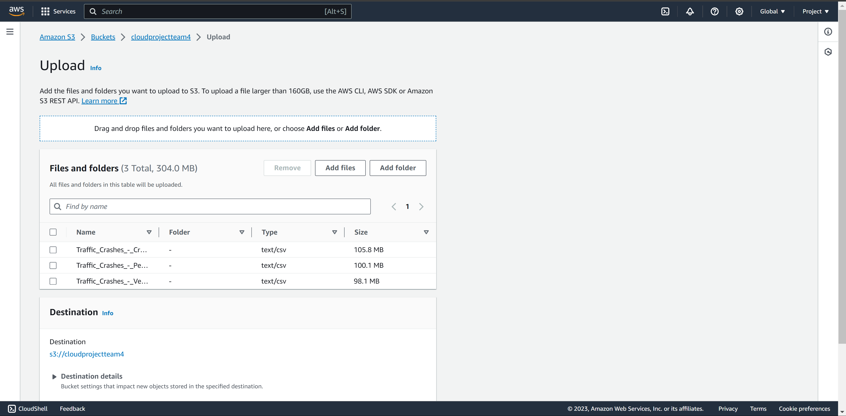
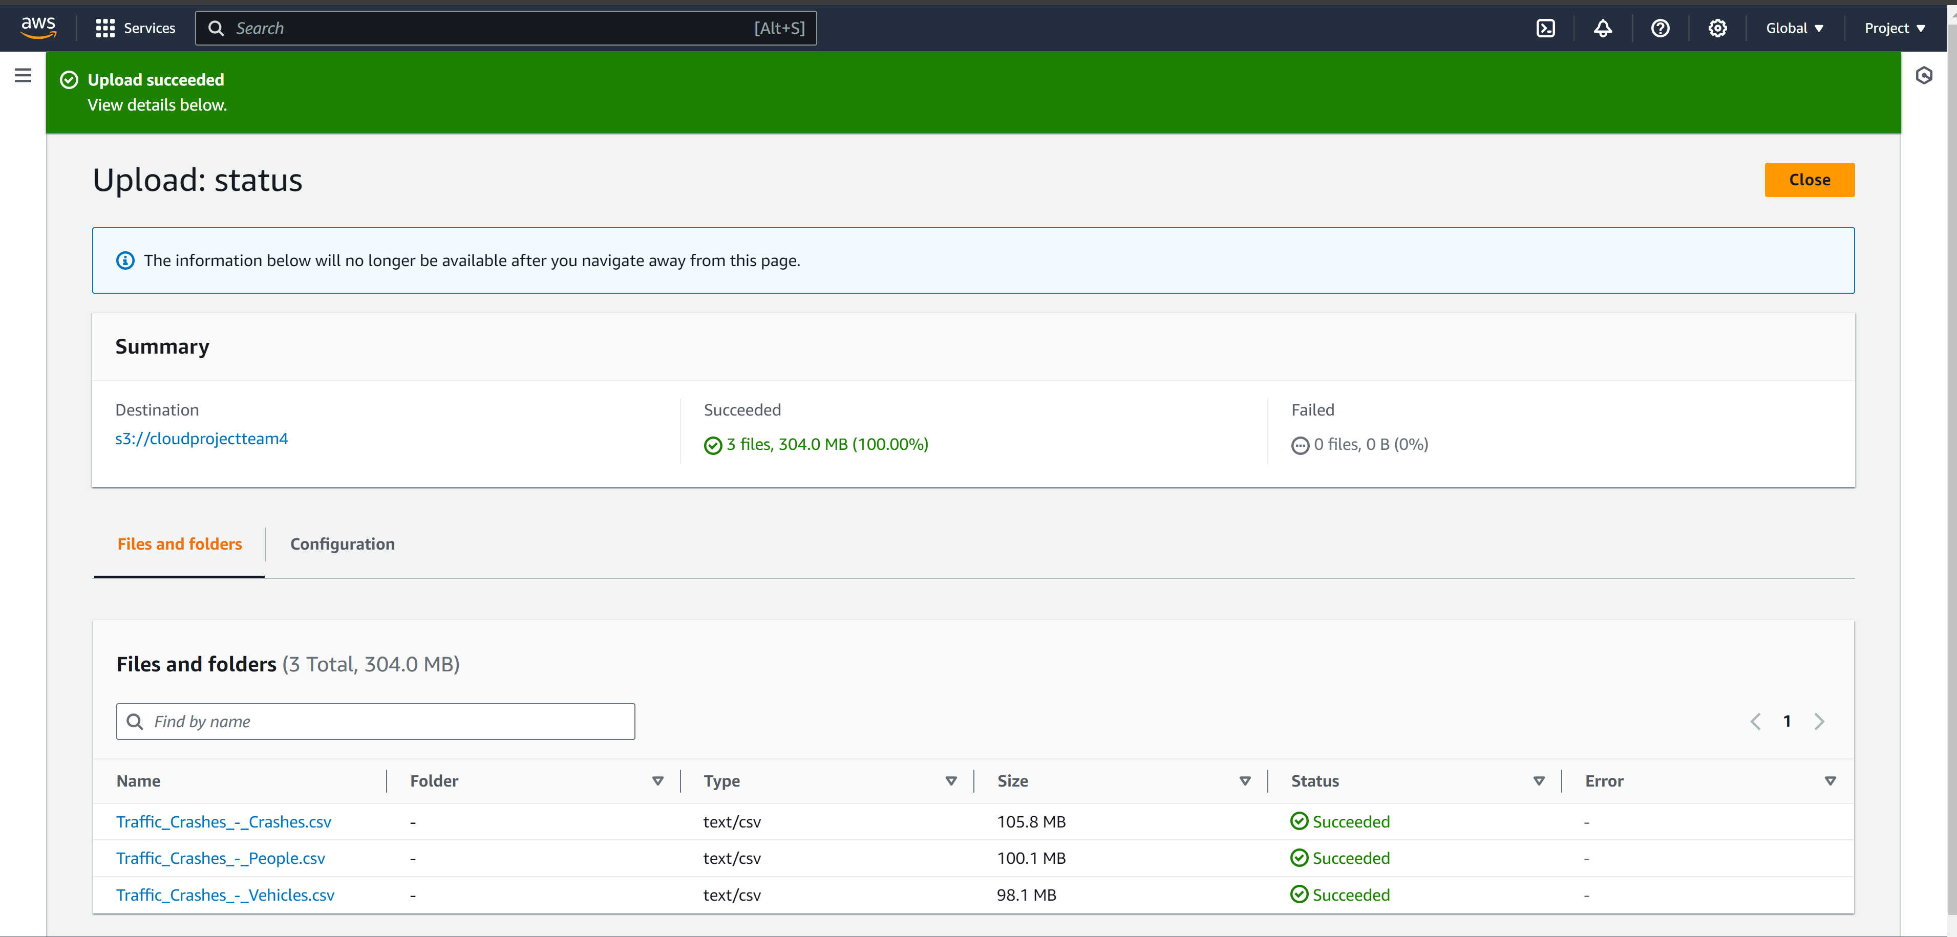
Store the dataset in S3 Bucket
We initiate the storage of our datasets by creating an S3 bucket through the AWS Management Console

Slide 8
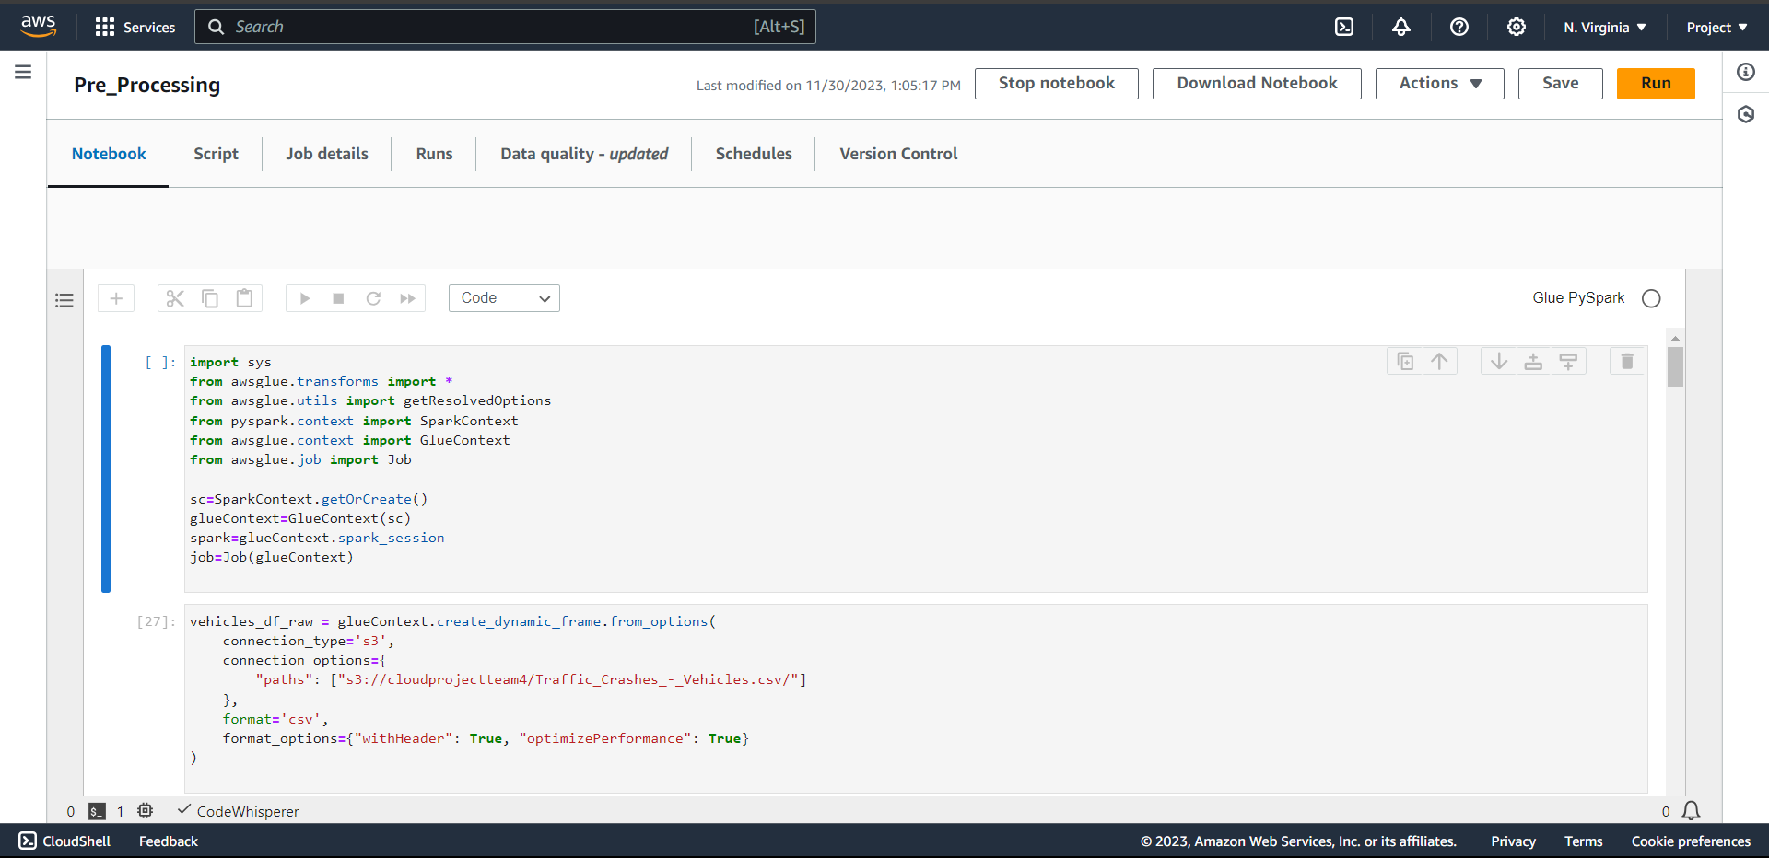
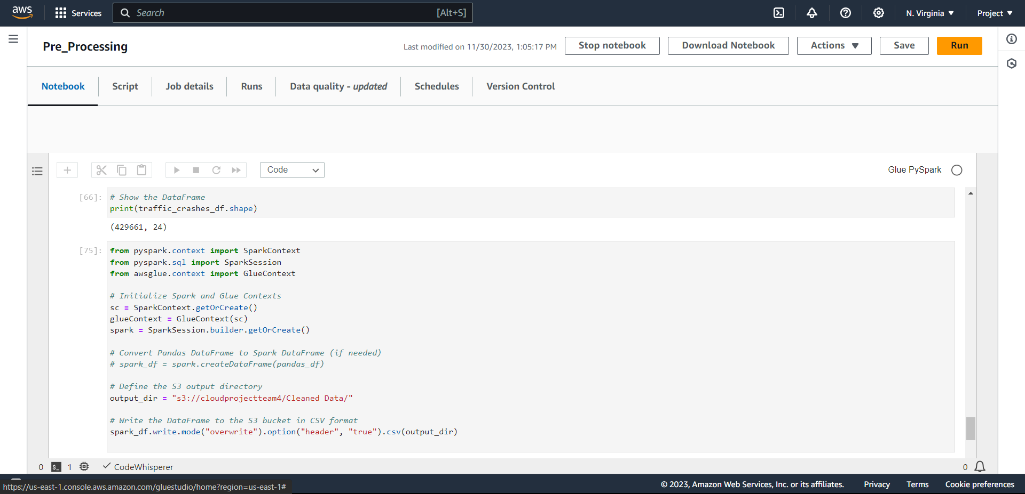
Clean and transform the data in AWS Glue
AWS Glue service simplifies the
task of cleaning and transforming diverse datasets for our analytics
and reporting purposes.

Slide 9
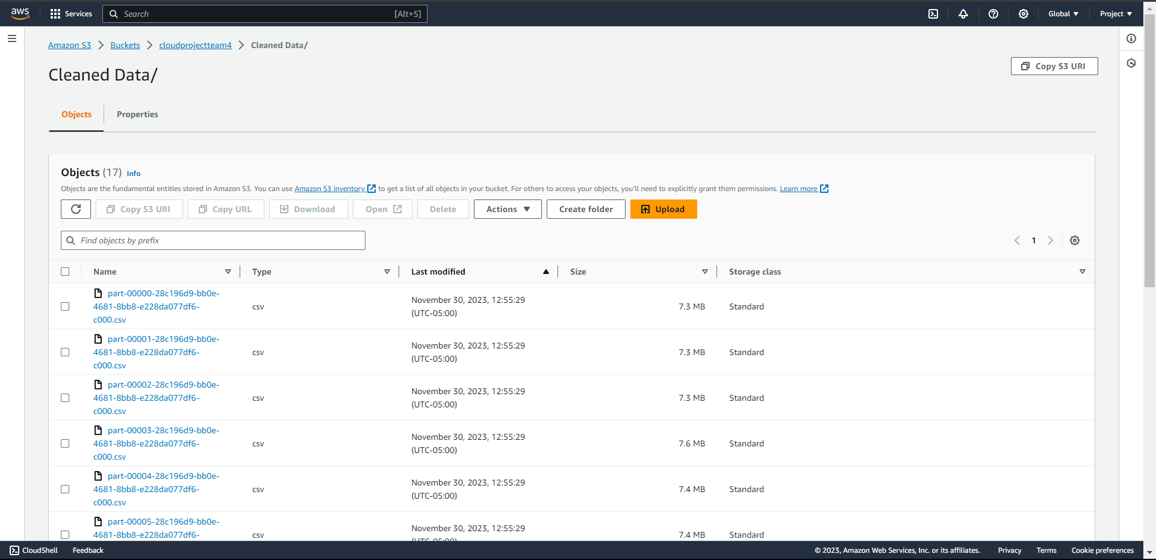
Store the cleaned and transformed data in S3 Bucket

Slide 10
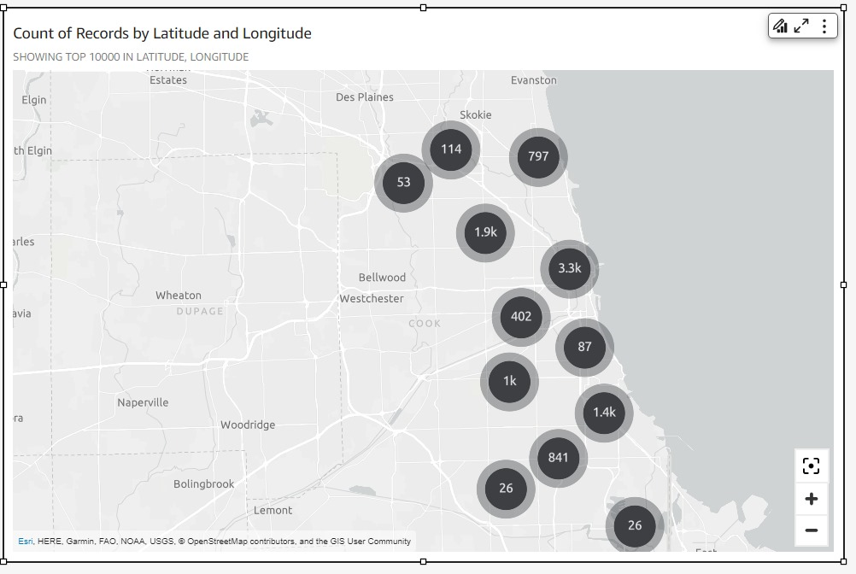
Created interactive visualizations using AWS Quick Sight
Identification of High-Risk areas
We have identified specific areas in Chicago such as Chicago Downtown, Logan Square, and South Chicago with the highest crash rates.

Slide 11
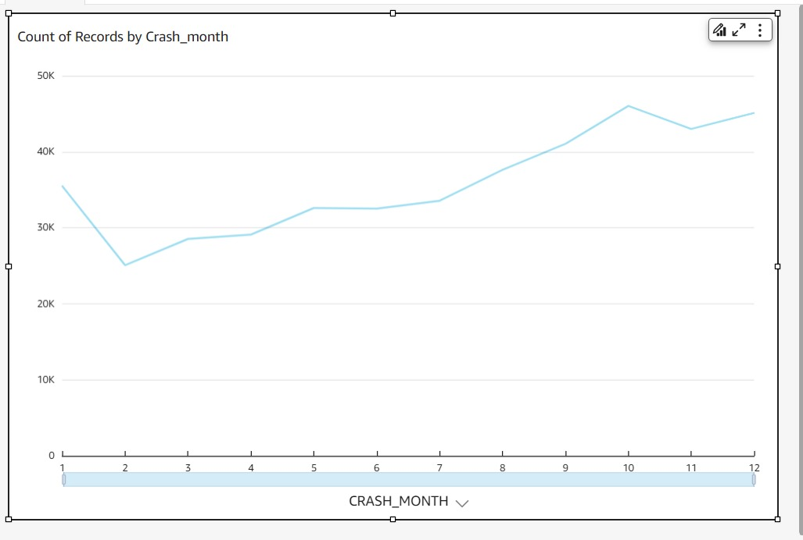
Trend Analysis
We discovered patterns in traffic accidents by month and discovered that the winter season had the biggest peak of collisions when compared to the other seasons.

Slide 12
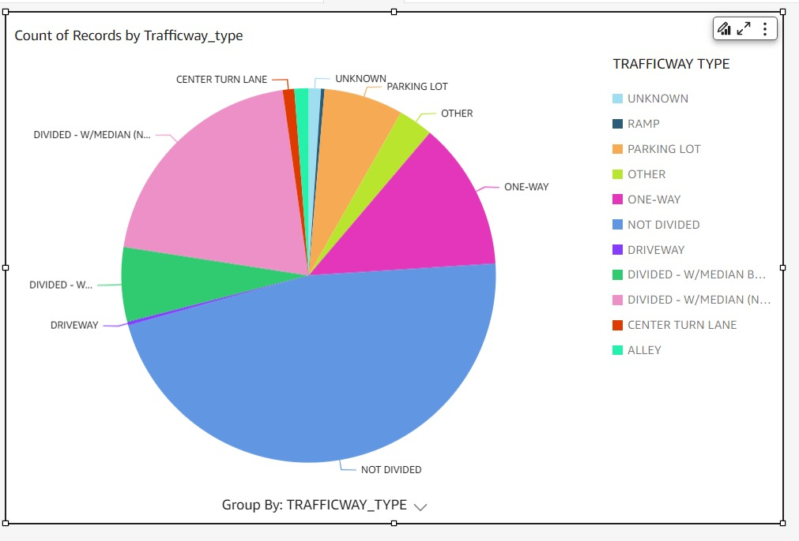
Causal Factors – Based on Trafficway Type
The primary factors contributing to accidents in our analysis are accidents that occurred due to Not Divided Roads.

Slide 13
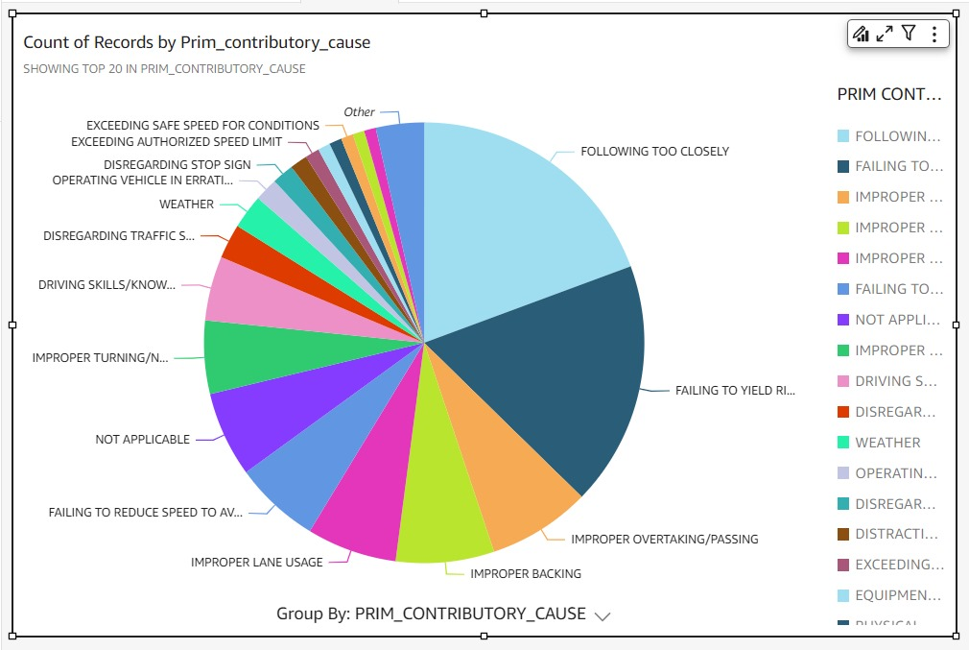
Causal Factors – Based on Primary Contributor
Accidents that occurred by following too closely and failing to yield RIGHT-OF-WAY.

Slide 14
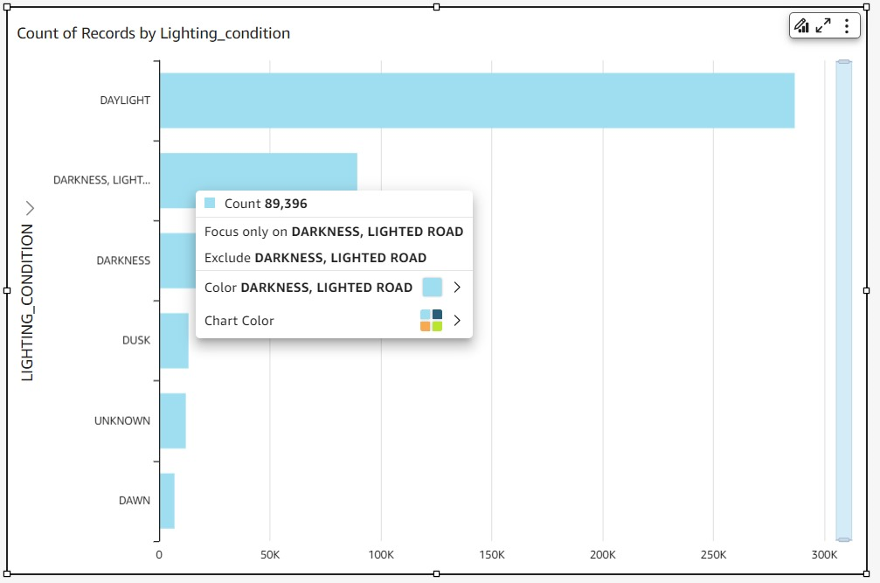
Climatic Conditions
We could infer from the climatic conditions that the majority of collisions occur during daylight.

Slide 15
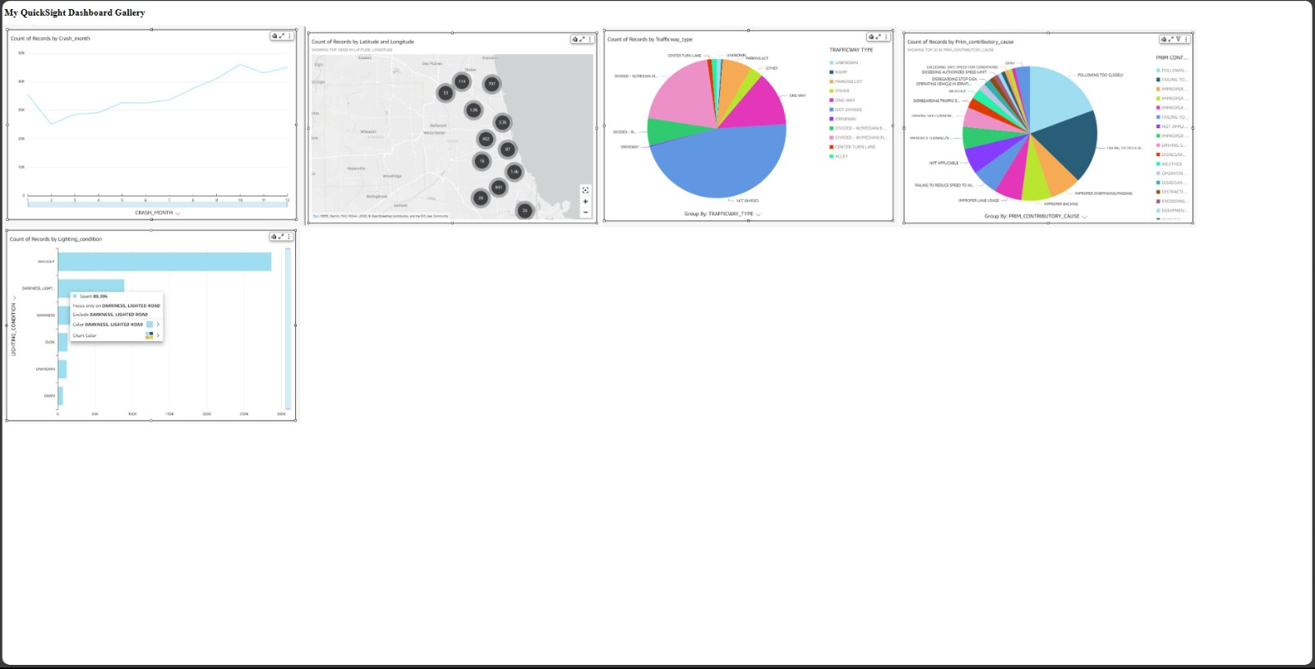
Host a Static Website present our dashboard

Slide 16
Summary & Next Steps:
Identification of High-Risk Areas
Chicago Downtown, Logan Square, and South Chicago noted for highest crash rates.
Trend Analysis
Winter season exhibits the highest peak of collisions compared to other seasons.
Causal Factors – Trafficway Type
Primary accidents occurred on Not Divided Roads.
Causal Factors – Primary Contributor
Accidents primarily resulted from following too closely and failing to yield RIGHT-OF-WAY.
Climatic Conditions
Majority of collisions occur during daylight hours.
By Implementing safety measures, conducting awareness campaigns and continuous monitoring can minimize the crash rate in the Chicago city.

Slide 17
THANK YOU

